Slide 1

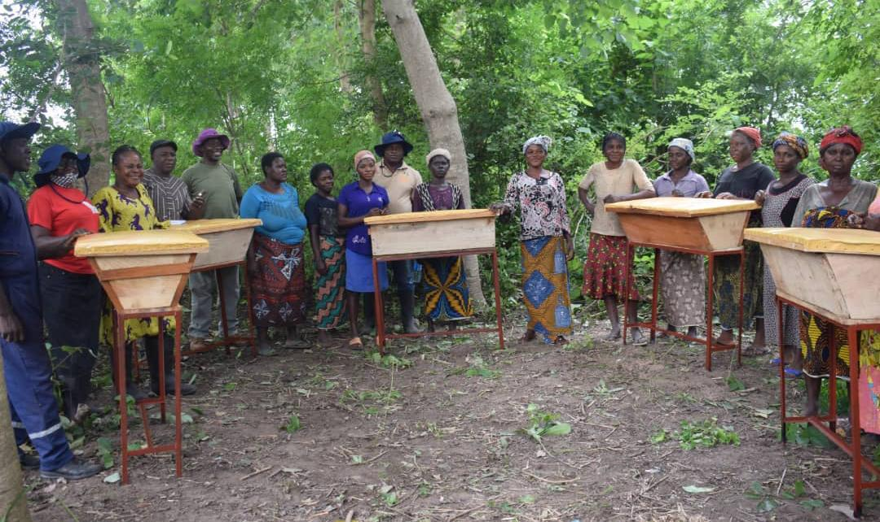
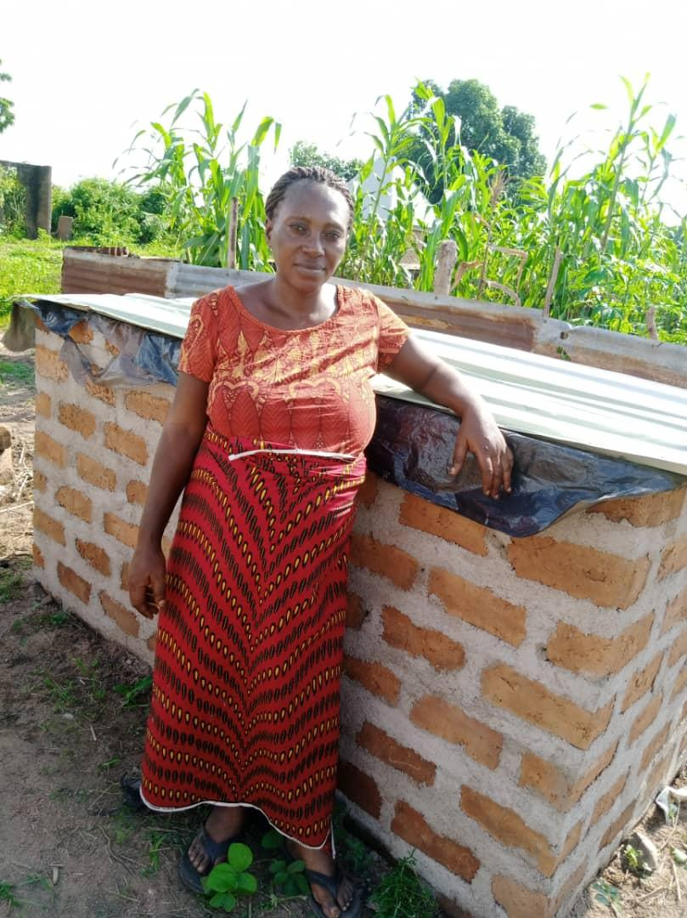


FOSTERING SUSTAINABILITY AND RESILIENCE FOR FOOD SECURITY IN THE SAVANNAH ZONES OF NORTHERN NIGERIA

Slide 2
Presentation Objective
To share our experience on gender implementation in projects

Slide 3
Preamble
The project by design targets only women and youths as the direct beneficiaries which means that every project activities that beneficiaries participate are women 33% while youth( Male=50%, Female=50%) take 67%. Logically and in general, males participate at 33.5% while females participate at 66.5%
The Project carried out a Gender study to generate information on gender gaps as well as, gender roles, gender participation in agricultural values chains, needs, constraints and opportunities of women and men in the project target areas. The study helped to establish a baseline information in order to inform interventions and better track the impacts of such interventions during the life of the project.

Slide 4
Brief from the Study
Household decision making around productive and income generating activities in the past 12 months in the project area revealed that men dominated the household decision making
Men had more access to nine (64.3%) while Women had more access to five (35.7%) out of 14 productive resources identified, out of the eight activities analyzed, it is only in food crop farming decision that women were rated higher than men in decision making.
Out of the 12 productive activities or roles investigated, women/girls participated more in eight (66.7%) while men/boys participated more in only four (33.3%).
Women/girls participated more in 9 out of the 12 identified reproductive roles representing 75% while men/boys participated more in only three (25%).
50% of the women reported that it is very true that men have claim over their labour while 45% of women also reported that they have difficulties obtaining sufficient labour during peak period for their own personal farming activities. About 82% of the community lands are owned by men while only 17.7% are owned by women

Slide 5
Our Approach
Robust and continuous sensitization of Men /Community and Religious leaders for Women’s Participation From Inception
Setting aside some interventions strictly for Women or giving women more slots/priority
Beneficiaries driven intervention which involves the project team at the state level sit with the beneficiaries to discuss livelihood support activities they can do as a source of additional income. All states came up with different activities depending on the interest of the various Cooperative groups

Slide 6
Activities
Bee Keeping– 80%
Goats dairy/Keeping/Production – 100%
Noodles Making Machines-100%
Contract Farming for Rice- -95%
Rice and G/Nut Processing & Value addition 95%
Mush room Farming- 79%
Seed Multiplication- 63%
Chemical spraying Machines – 24%
Ram Fattening – 4%

Slide 7
Outcome
Significant increase in women turn out is recorded due to awareness and increase in their economic life in all activities
Significant improvement in the wellbeing of the women beneficiaries which leads to great change in the nutritional status of their children
Many women are now acquiring/purchasing / increasing their farm lands due to series of benefits provided by the project. They are now bold to take on crop production alongside men especially in the case of rice production
Women now have income of their own and are paying school fees and taking up financial roles in supporting in their families
Women now contest for post in their mix cooperative groups and participate in decision making during community meeting
A total number of 38,901women benefited directly from both on-farm and off-farm livelihood activities.

Slide 8
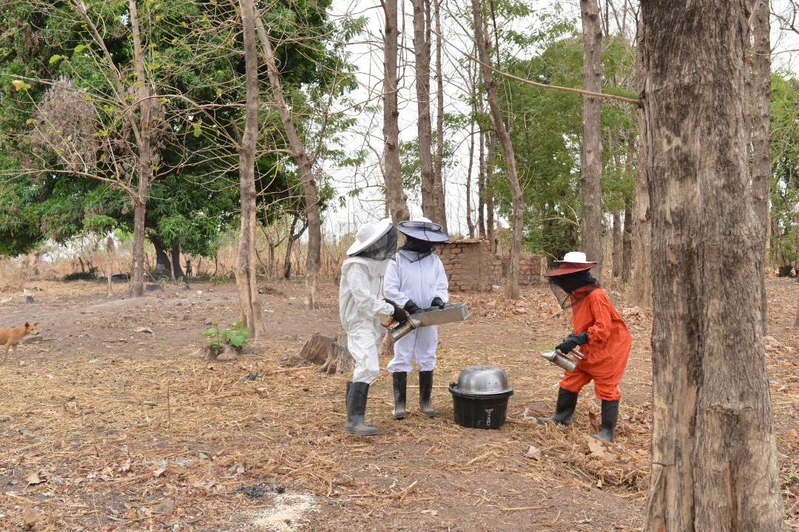
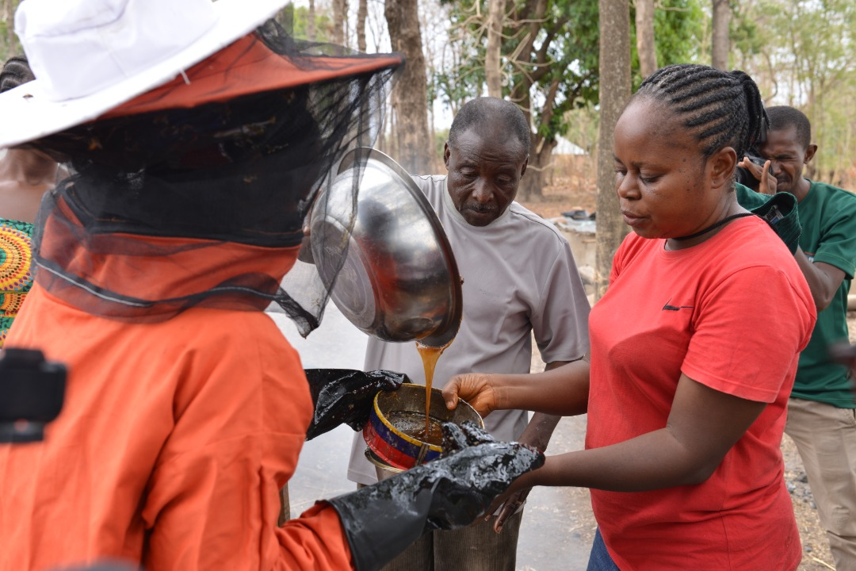
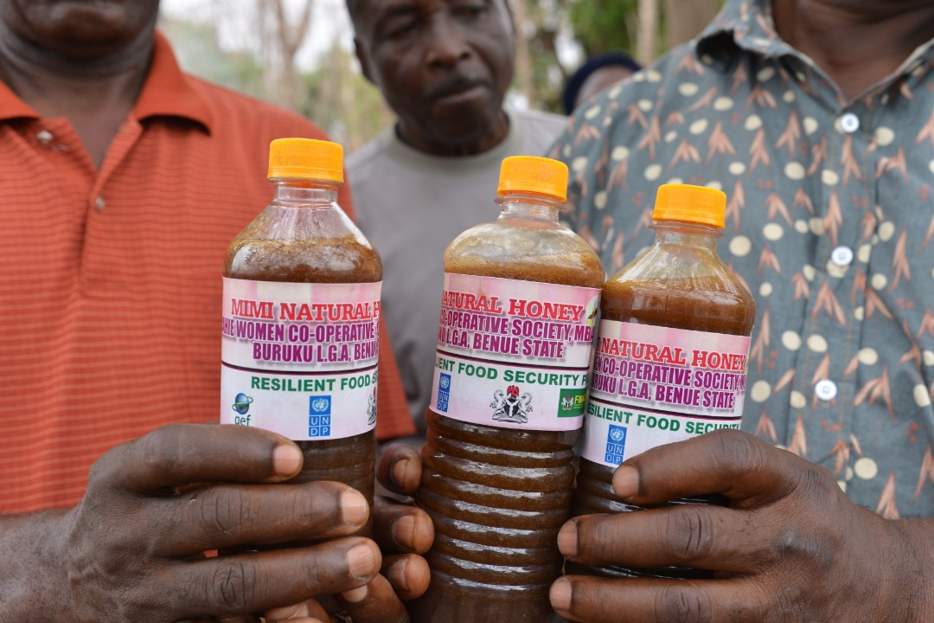
Women Harvesting & Packaging Honey

Slide 9
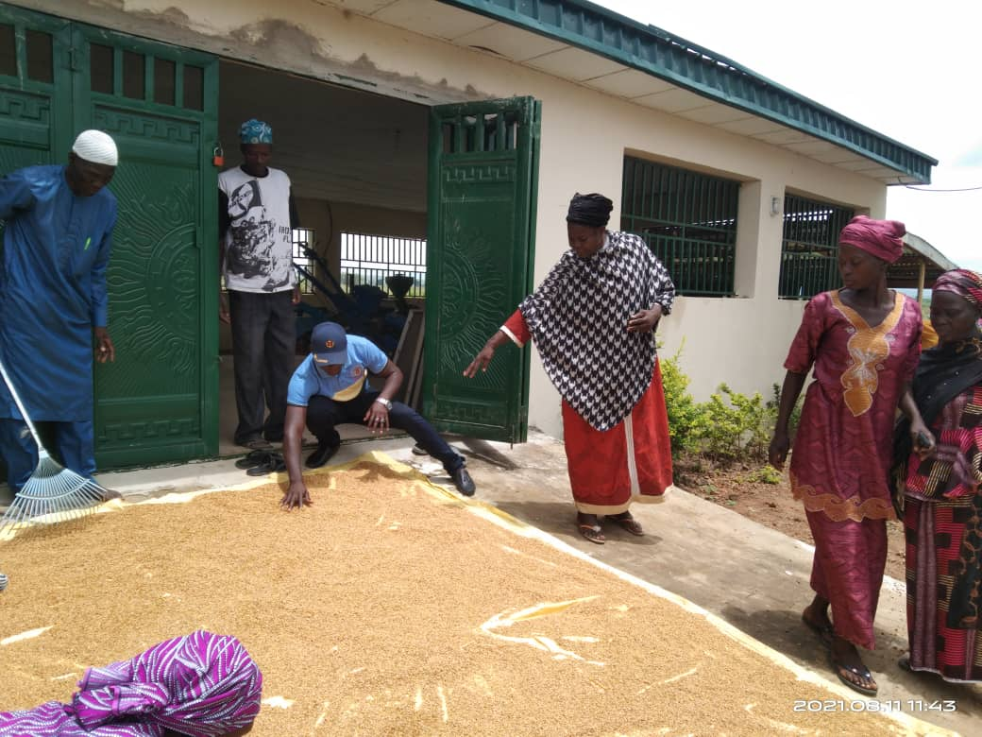
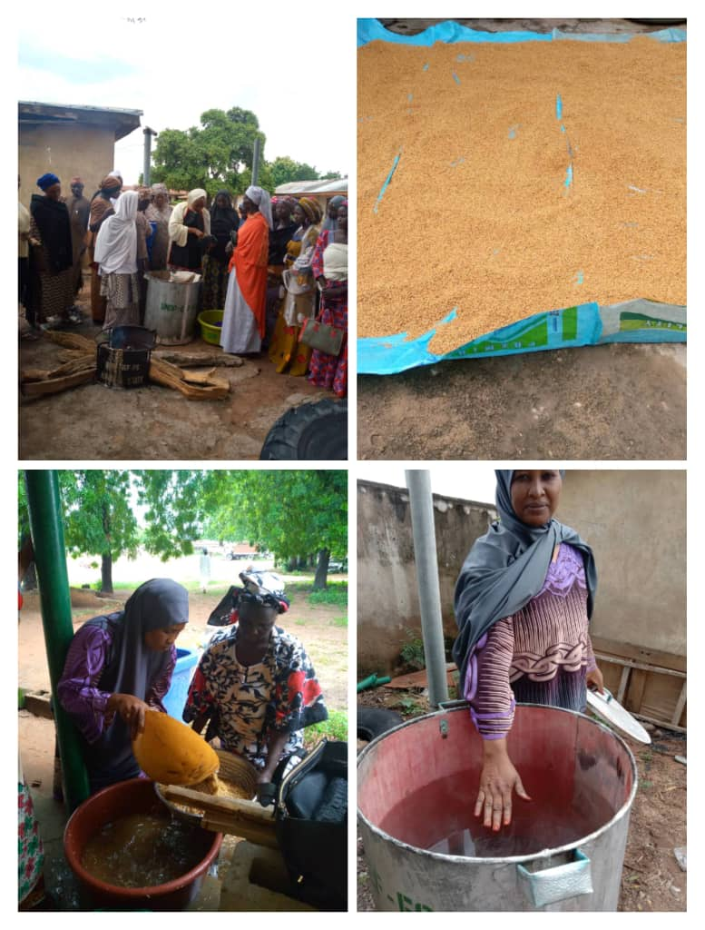
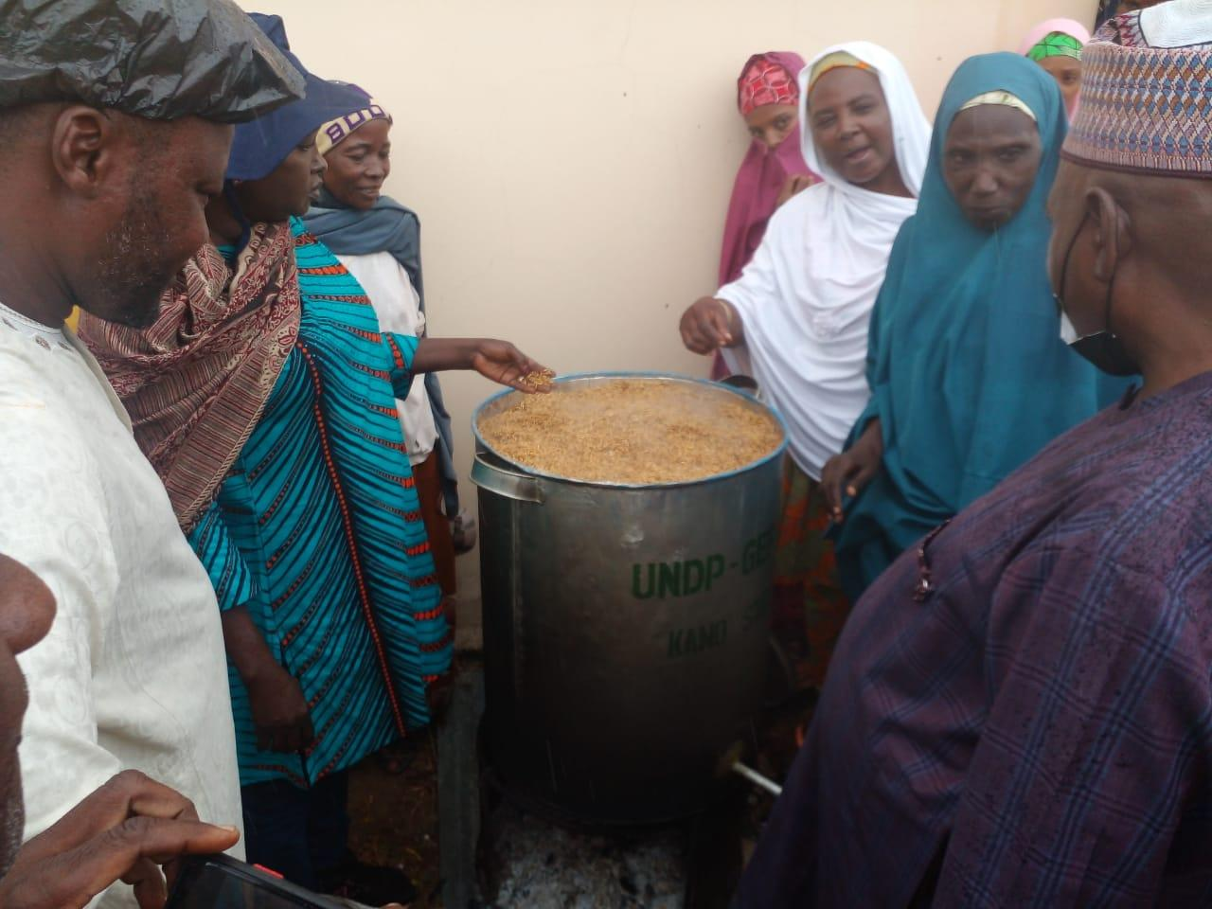
Rice Processing

Slide 10
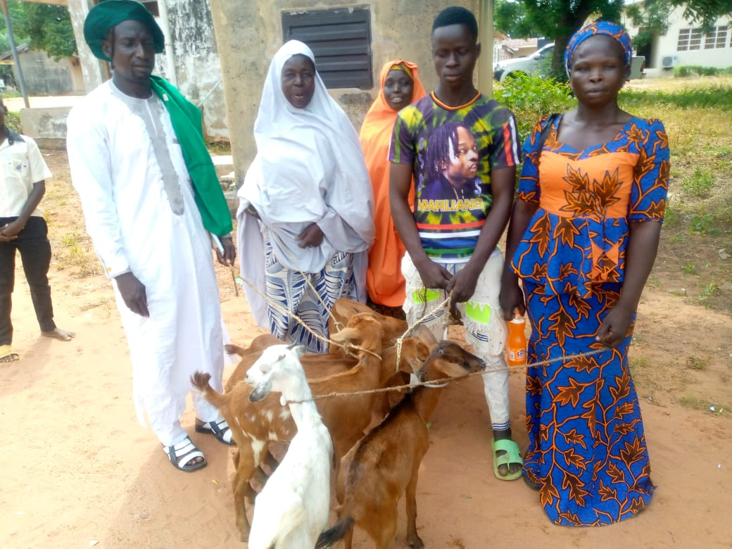
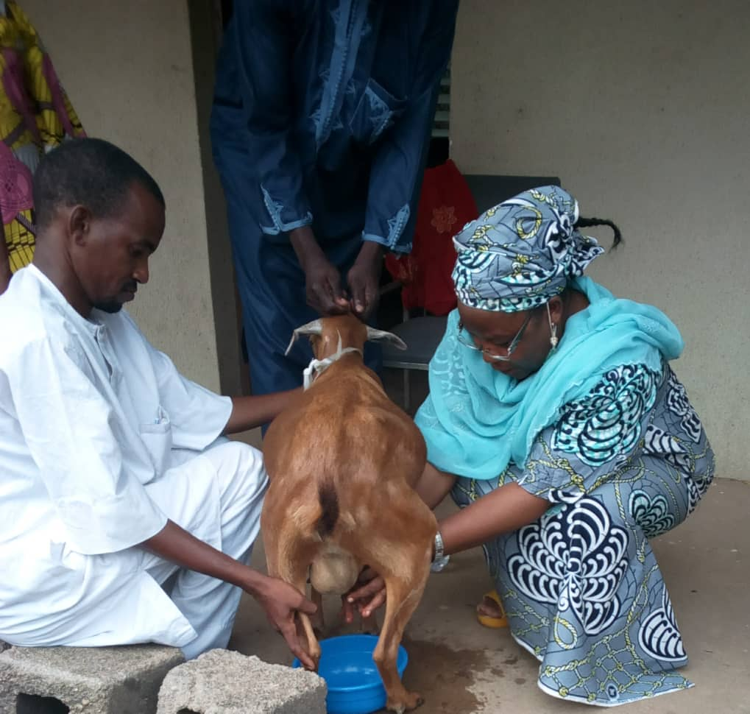
Goats dairy/Production

Slide 11
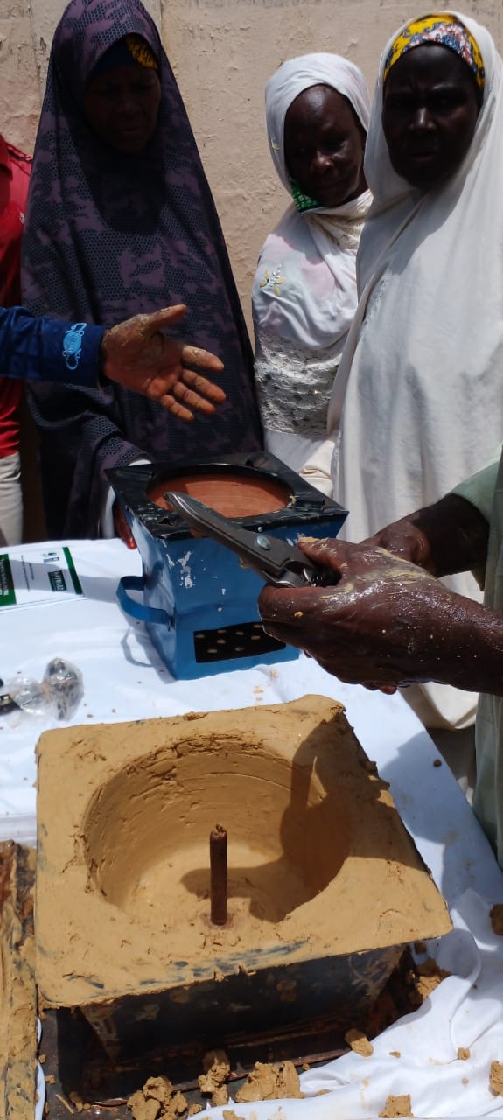
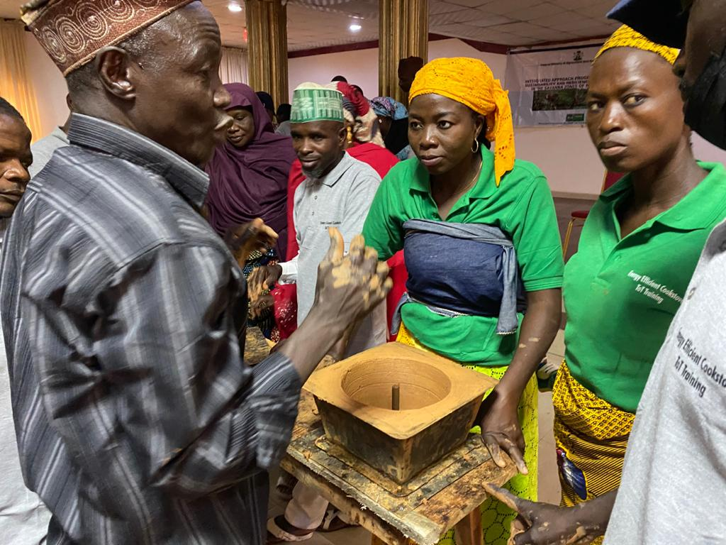
Production of Energy Efficient Cook stove

Slide 12
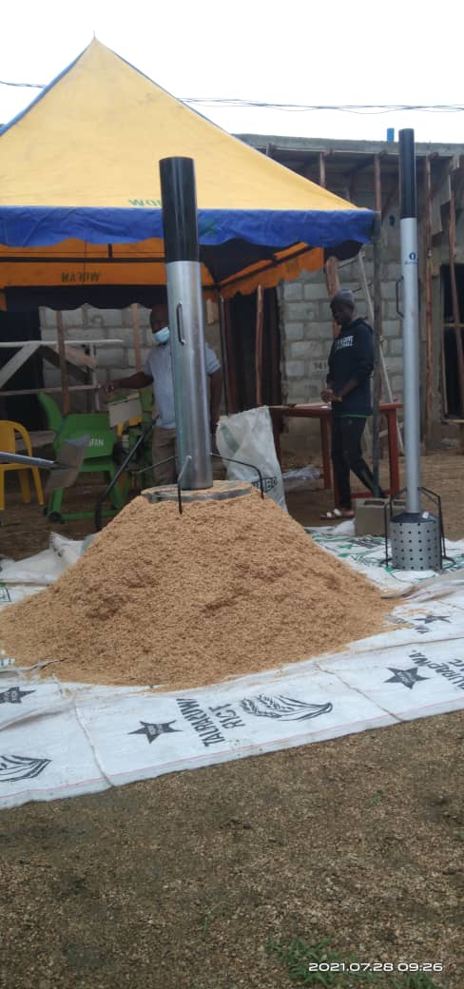
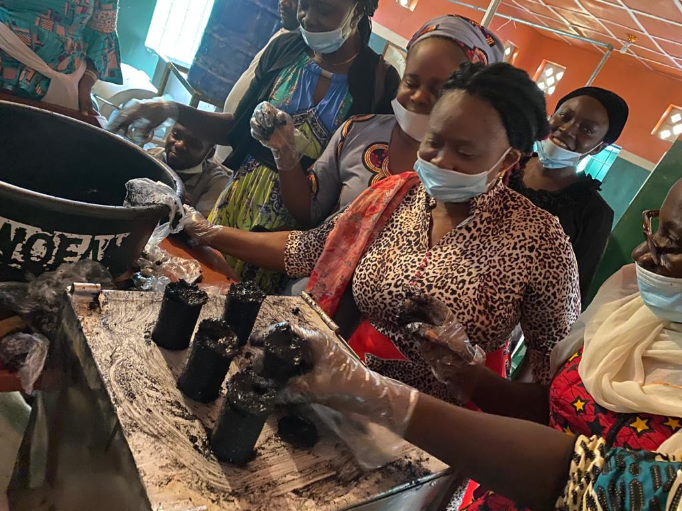
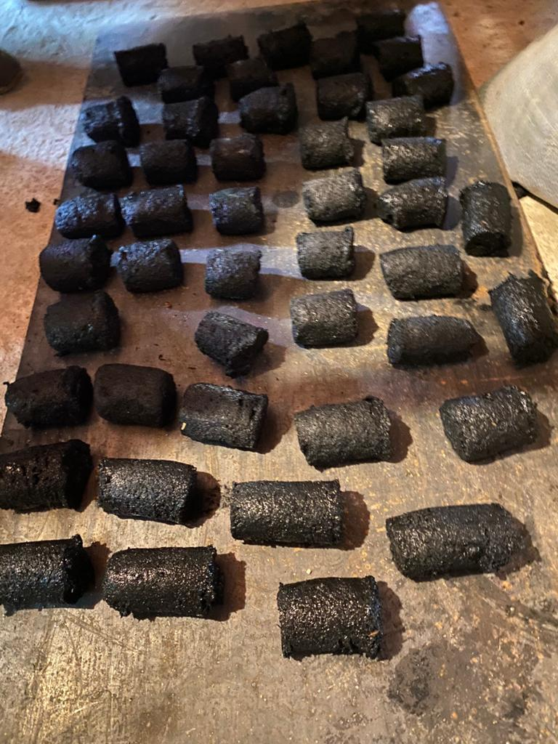
Carbonizing and making of Briquettes from Farm Residue

Slide 13
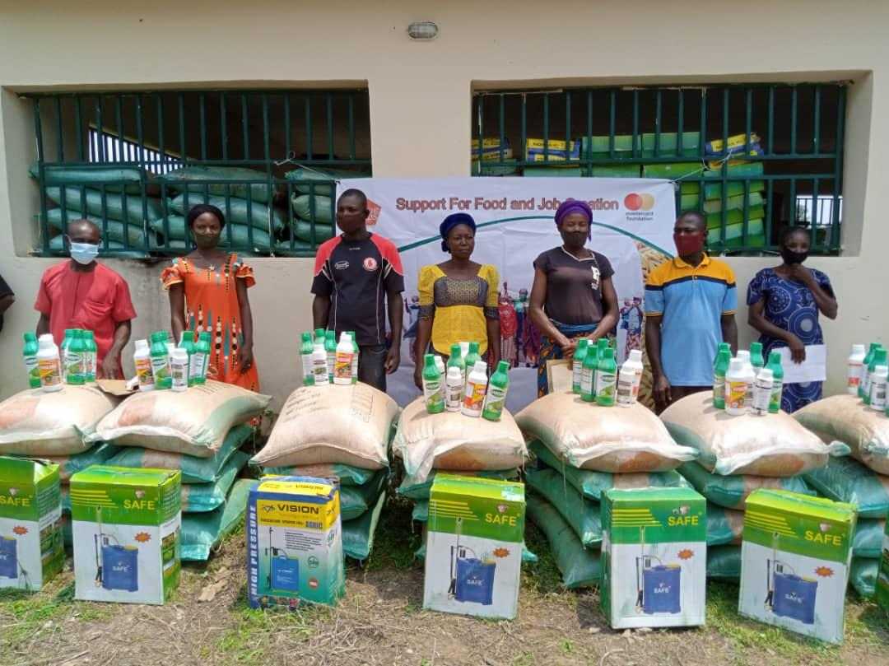
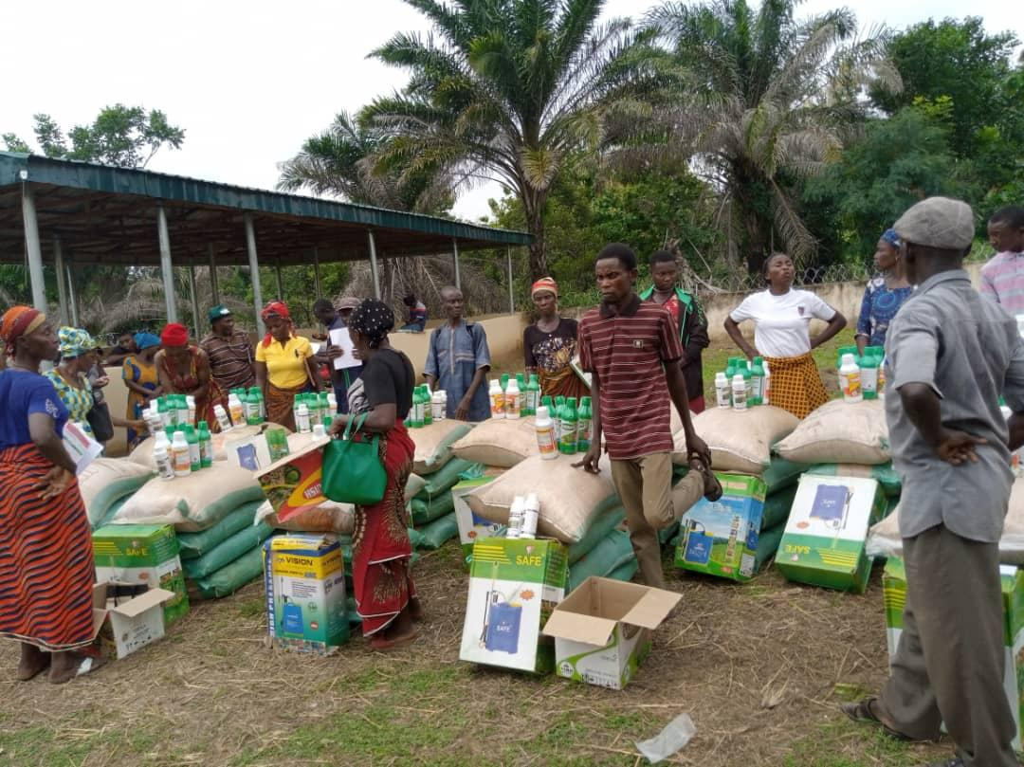
Rice Contract Farmers Collecting Inputs

Slide 14



